Slide 1


PREDICTIVE ANALYSIS OF MACHINE FAILURE
GROUP 89

Slide 2
Table of contents
Problem Setting
Problem Objective and Problem Definition
Data Source and Data Description
Data Preprocessing and Dimension Reduction
Exploratory Analysis
Model Building
Performance Evaluation
Reference
\

Slide 3
Problem Setting
Modern businesses rely heavily on machines and equipment to maintain their productivity and profitability. However, the performance of these machines can deteriorate over time, leading to costly downtime and repairs.
One approach to mitigate this issue is predictive maintenance, which aims to maximize machine efficiency and minimize unexpected breakdowns by predicting when maintenance is needed before a failure occurs.
Predictive maintenance involves collecting and analyzing data on various parameters of the machine, such as temperature, vibration, and other performance indicators. Tracking these metrics over time can identify patterns and anomalies, which can then be used to predict when a machine failure is likely to occur.
In the context of a manufacturing process, machine failures can occur for various reasons, such as wear and tear, operator errors, or other environmental factors. The challenge is understanding the factors contributing to machine failure and developing a predictive model that can accurately forecast when maintenance is required.

Slide 4
Problem Objective
The main objective of this project is to develop a predictive maintenance system for a manufacturing process that can help reduce downtime, minimize maintenance costs, and increase overall efficiency.
By using data analysis and machine learning techniques, the project aims to predict when a machine is likely to fail, allowing for proactive maintenance to be scheduled before any significant issues occur.
Ultimately, this will enable businesses to better plan and manage their maintenance activities, leading to improved machine uptime, reduced maintenance costs, and increased productivity.

Slide 5
Problem Definition
The specific problem being addressed is to identify the factors that contribute to machine failure and to predict when it is likely to occur. The following questions need to be answered through data analytics:
What are the factors that contribute to machine failure?
How can we predict when a machine is likely to fail?
Which failure mode is the most likely to occur?

Slide 6
Data Sources
Stephan Matzka, School of Engineering - Technology and Life, Hochschule fÃ¼r Technik und Wirtschaft Berlin, 12459 Berlin, Germany, stephan.matzka '@' htw-berlin.de
https://archive.ics.uci.edu/ml/datasets/AI4I+2020+Predictive+Maintenance+Dataset#

Slide 7
Data Description
The dataset consists of 10,000 data points stored as rows with 14 features in columns. The variables include:
UID: unique identifier ranging from 1 to 10,000
product ID: consisting of a letter L, M, or H for low (50% of all products), medium (30%), and high (20%) as product quality variants and a variant-specific serial number
air temperature [K]: generated using a random walk process later normalized to a standard deviation of 2 K around 300 K
process temperature [K]: generated using a random walk process normalized to a standard deviation of 1 K, added to the air temperature plus 10 K.
rotational speed [rpm]: calculated from a power of 2860 W, overlaid with a normally distributed noise
torque [Nm]: torque values are normally distributed around 40 Nm with an Ïƒ = 10 Nm and no negative values.
tool wear [min]: The quality variants H/M/L add 5/3/2 minutes of tool wear to the used tool in the process.
‘ machine failure' label: indicates whether the machine has failed in this particular data point.

Slide 8
Five Independent Failure Modes of the Machine
Tool wear failure (TWF): the tool will be replaced of a fail at a randomly selected tool wear time between 200 – 240 mins (120 times in our dataset). At this point in time, the tool is replaced 69 times and fails 51 times (randomly assigned).
Heat dissipation failure (HDF): heat dissipation causes a process failure, if the difference between air- and process temperature is below 8.6 K and the tool’s rotational speed is below 1380 rpm. This is the case for 115 data points.
Power failure (PWF): the product of torque and rotational speed (in rad/s) equals the power required for the process. If this power is below 3500 W or above 9000 W, the process fails, which is the case 95 times in our dataset.
Overstrain failure (OSF): if the product of tool wear and torque exceeds 11,000 min Nm for the L product variant (12,000 M, 13,000 H), the process fails due to overstrain. This is true for 98 data points.
Random failures (RNF): each process has a chance of 0,1 % to fail regardless of its process parameters. This is the case for only 5 data points, less than could be expected for 10,000 data points in our dataset.

Slide 9
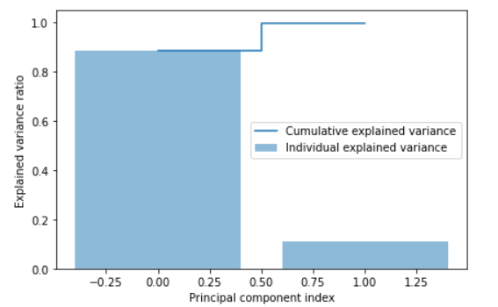
Data Pre-processing and Dimension Reduction
Applied Principal component Analysis to the training dataset.
The variances captured by the first 2 components are 88.75% and 11.16%.

Slide 10
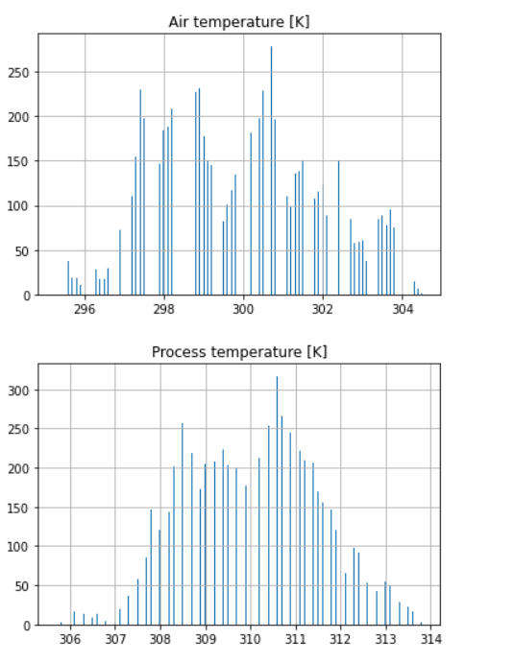
Exploratory Analysis: Histograms for each numerical variable
Air temperature [K]: The distribution is approximately normal with a slight left skew. The majority of the values fall between 295 K and 305 K.
Process temperature [K]: The distribution is approximately normal with a slight left skew. The majority of the values fall between 310 K and 320 K.

Slide 11
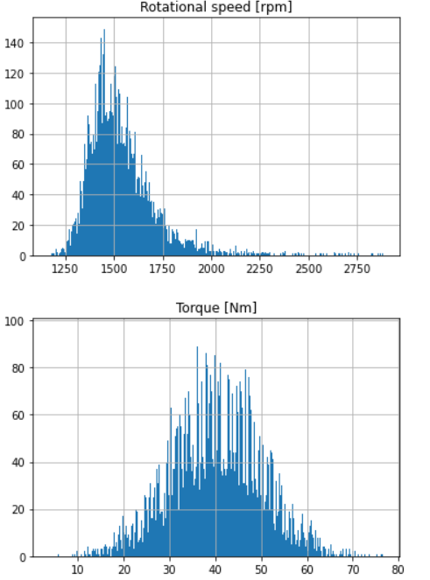
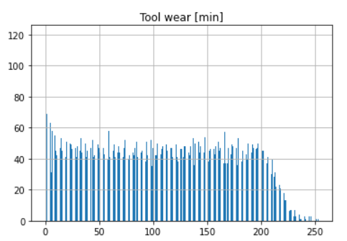
Exploratory Analysis: Histograms for each numerical variable
Torque [Nm]: The distribution is approximately normal with a slight left skew. The majority of the values fall between 25 Nm and 50 Nm.
.
Tool wear [min]: The distribution is right-skewed, with most values falling below 50 minutes. There is a long tail of values up to around 200 minutes.
Rotational speed [rpm]: The distribution is roughly bimodal with peaks around 1375 and 1725 rpm. There is a dip in the middle around 1550 rpm.

Slide 12
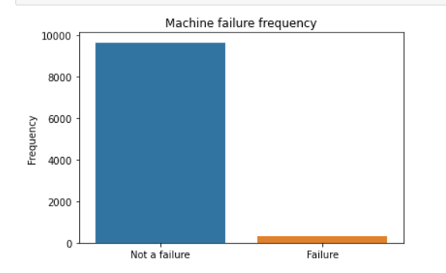
Exploratory Analysis: Frequency of machine failure
The graph displays machine failure frequency in the dataset, with more instances of "Not a failure" (0) than "Failure" (1).
Although most machines did not experience failure, a substantial number did, indicating the need for further analysis to identify contributing factors.

Slide 13
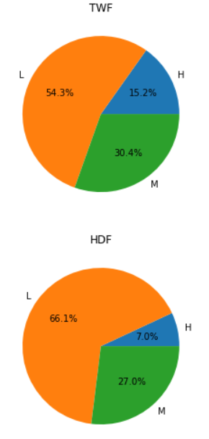
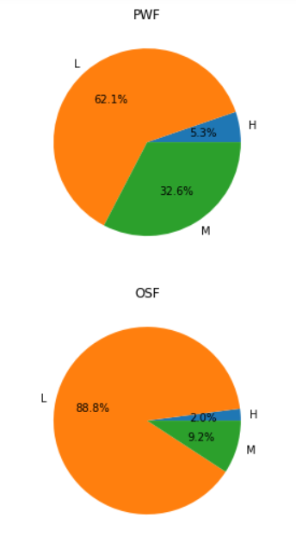
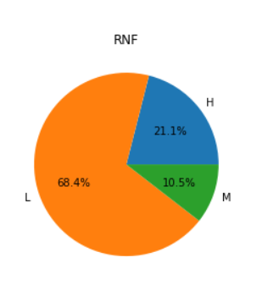
Exploratory Analysis: Pie chart for each category of failure types

Slide 14
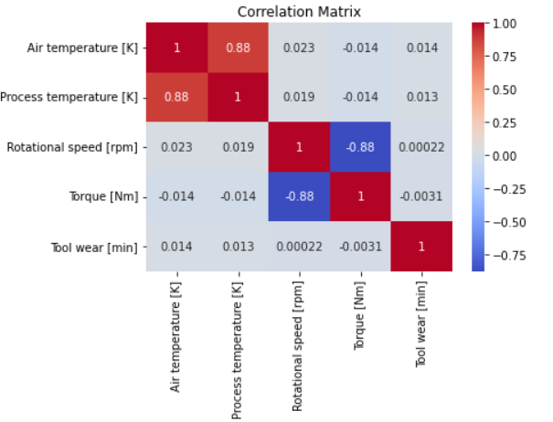
Exploratory Analysis: Correlation plot for correlation matrix

Slide 15
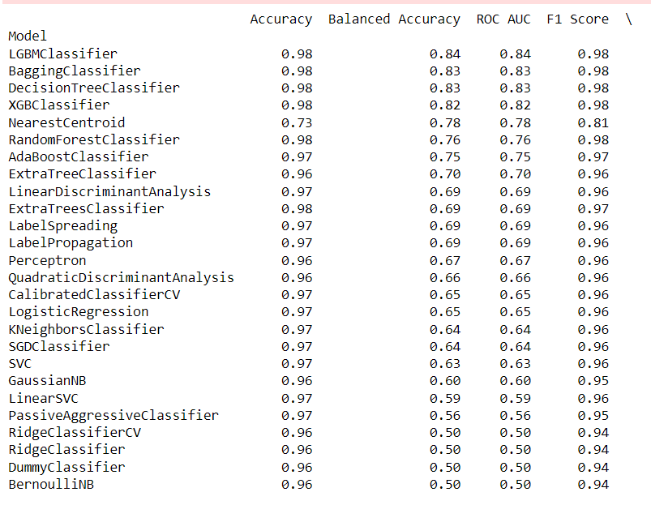
Exploration of Candidate Data Mining Models and Selecting the Final Model.
Select only relevant columns and apply one-hot encoding on the Type column
Split data into training and testing sets: X_t, X_te, y_t, y_te
Creating train and evaluation sets: X_train, X_test, y_train, y_test
Applying lazypredict library on X_train, X_test, y_train, y_test to obtain baseline estimates for model performance.
After applying from the above results, we can see XGBoost, Random Forest, Decision Trees Classification, AdaBoost classifier, and KNeighbors classifier algorithms are performing well.

Slide 16
Data Mining Model
The following models were used :
XGBoost
Random Forest
Decision Trees
AdaBoost classifier
KNeighbors classifier

Slide 17
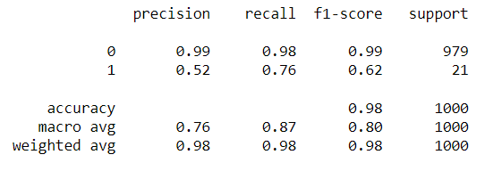
Model Building : XGBoost
Performing feature scaling using the Normalization technique.
Transforming the X_train.
Applying modelling.
Transforming the X_test and X_te
Accuracy score for y_te is 0.98
Classification report for the predictions and y_te :

Slide 18
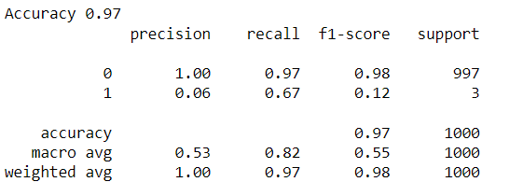
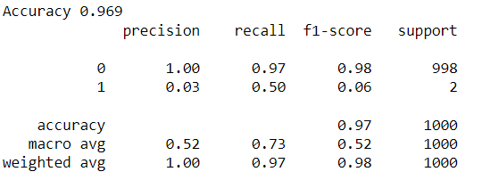
Model Building : Random Forest
Fitting the random forest classifier RandomForestClassifier(max_depth=5, random_state=0)
Accuracy score for y_test is 0.97111
Classification report for the random forest classifier
Fitting the random forest classifier RandomForestClassifier(max_depth=3, random_state=0)
Accuracy score for y_test is 0.969
Classification report for the random forest classifier

Slide 19
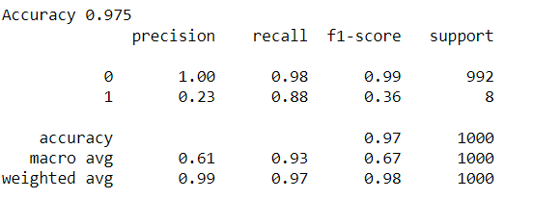
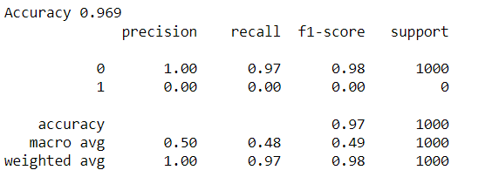
Model Building : Random Forest
Fitting the random forest classifier RandomForestClassifier(max_depth=7, random_state=0)
Accuracy score for y_test is 0.975
Classification report for the random forest classifier
Fitting the random forest classifier RandomForestClassifier(max_depth=1, random_state=0)
Accuracy score for y_test is 0.969
Classification report for the random forest classifier

Slide 20
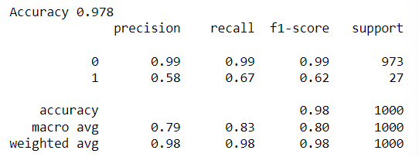
Model Building : Decision Tree
Fitting the Decision tree classifier:
DecisionTreeClassifier(random_state=0)
Accuracy score for y_te is 0.978
Classification report for decision tree classifier :

Slide 21
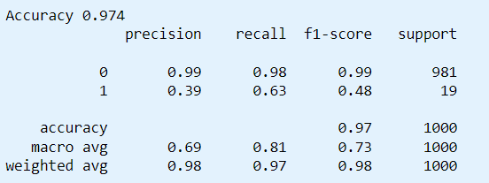
Model Building : AdaBoost Classifier
Fitting the adaboost classifier
Accuracy score for y_test is 0.974
Classification report for Adaboost classifier :

Slide 22
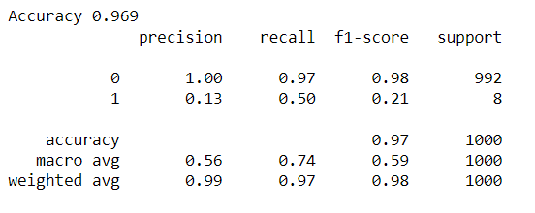
Model Building : Kneighbors Classifier
Fitting the KNeighborsclassifier
Accuracy score for y_test is 0.969
Classification report for Kneighbors classifier :

Slide 23
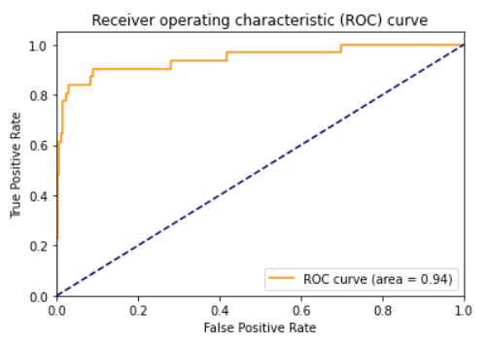
Model Building and Performance evaluation
Based on the experimentation with multiple algorithms, XGBoost gave the highest accuracy, making it the ideal choice for our model.
We will continue to use the XGBoost algorithm for Model Performance Evaluation.

Slide 24
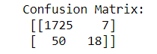
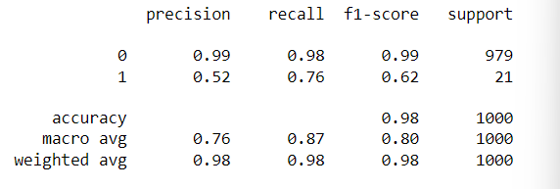
Performance Evaluation
Confusion Matrix:
Accuracy score for the y_test is 0.98 Classification Report:

Slide 25
Performance Evaluation : Comparison of model performance
Model Name
Model Name | Accuracy | Precision
XGBoost | 0.98 | 0.99
Random Forest | 0.975 | 0.99
Decision Trees | 0.978 | 0.98
AdaBoost classifier | 0.974 | 0.99
K-Neighbors classifier | 0.969 | 0.99

Slide 26
Conclusion and Key take aways
We have implemented five models XGBoost, Random Forest, Decision Trees, AdaBoost classifier, and K-Neighbors classifier.
After analyzing various algorithms, XGBoost demonstrated the maximum accuracy, making it the best option for our model with an accuracy of 0.98 and a precision of 0.99.
The area under the ROC curve is 0.94 which suggests that the classifier and the algorithm used has an excellent performance in distinguishing between positive and negative cases.
An AUC of 0.94 indicates that the algorithm used has correctly identified positive cases with a high degree of accuracy while keeping the false positive rate relatively low
Ultimately, we can draw a conclusion that our model predicts the failure of the machine with 98% accuracy which shows that the model works well.

Slide 27
References
https://archive.ics.uci.edu/ml/datasets/AI4I+2020+Predictive+Maintenance+Dataset#

Slide 28
Thank you….

